Slide 1
Exploratory Data Analysis on Suicides in India

Slide 2

Hello!
I am Thomaskutty Emmanuel
You can find me at:
INSAID:Thomaskutty619
Mail:thomaskuttyemmanuel@gmail.com

Slide 3

PROBLEM STATEMENT
Analysis the pattern or category of people from the previous suicides to know which category needs support.

Slide 4
DATASET
Contains 12768 rows and 16 columns.
Columns:
STATE/UT
YEAR
CAUSE
Male upto 14 years
Male 15-29 years
Male 30-44 years
Male 45-59 years
Male 60 years and above
Total Male
Female upto 14 years
Female 15-29 years
Female 30-44 years
Female 45-59 years
Female 60 years and above
Total Female
Grand Total

Slide 5

ANALYSIS
Gender
Age
State/UT
Reason

Slide 6
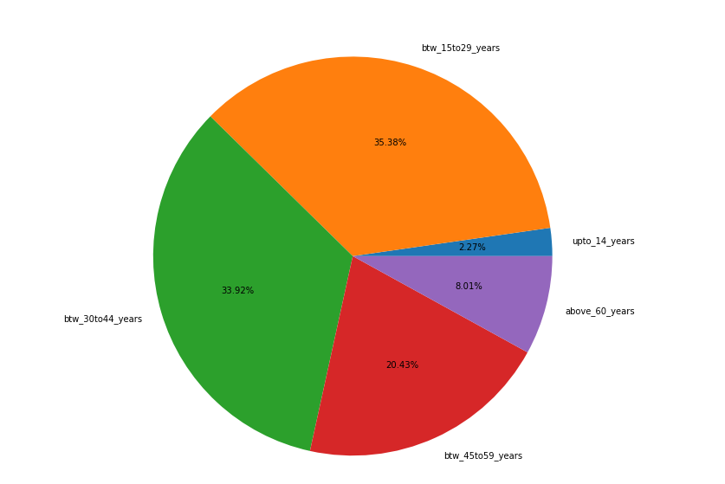
AGE GROUP
Most of the people who committed suicide belongs to the age group 15 to 44.
About 35.38% belongs to 15 to 29 years of age and 33.92% belongs to 30 to 44 years of age.
Total 69.3% people had the age between 15 to 44.
Children up to 14 years of age commit less suicides(only 2.27%) compared to other age group.

Slide 7
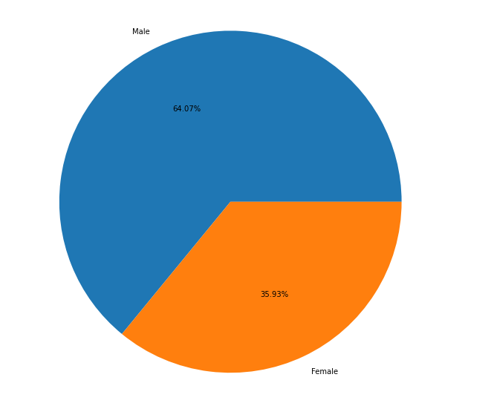

GENDER
64.07 % of people who committed suicide are male. Nearly double of Female.
35.93 % are Female.

Slide 8
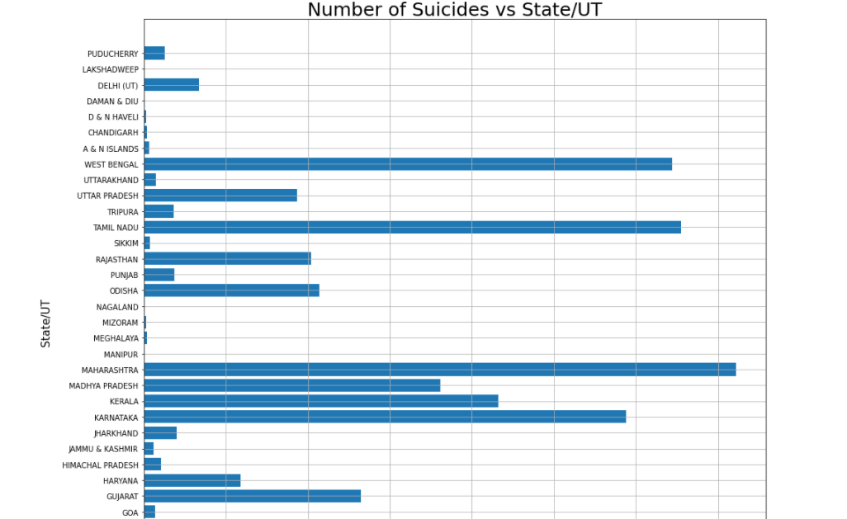
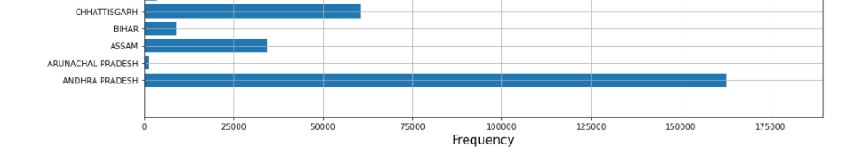
STATE/UT

Slide 9

Top 5 States/UT where number of people committed suicide is very high:
- Maharashtra
- Andhra Pradesh
- Tamil Nadu
- West Bengal
Top 5 States/UT where number of people committed suicide is very less:
- Lakshadweep
- Daman & Diu
- Nagaland
- Manipur
-Mizoram

Slide 10
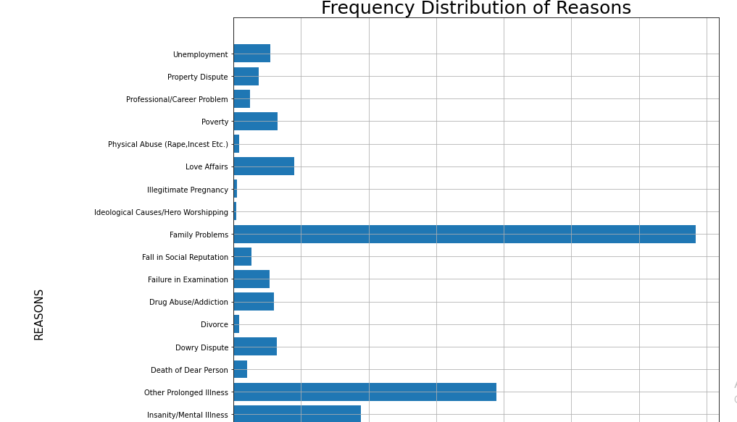
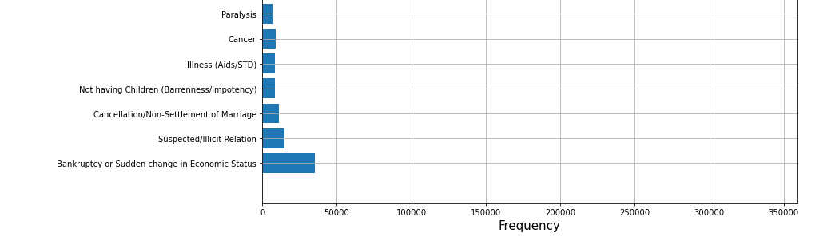
REASON
Top 3 reasons for people to commit suicide:
- Family Problems(Nearly 3 lakh 50 thousand people)
- Other prolonged illness(Nearly 2 lakh people)
- Insanity/Mental illness(Nearly 1 lakh people)

Slide 11
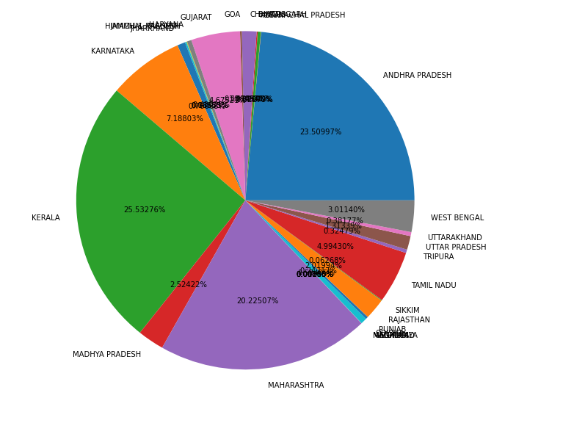
BANKRUPT
Most number of people committed suicide due to bankrupt belongs to Kerala(25.53%)
Second- Andhra Pradesh with 23.50%
Third- Maharashtra with 20.22%

Slide 12
AGE GROUP vs REASON

Slide 13
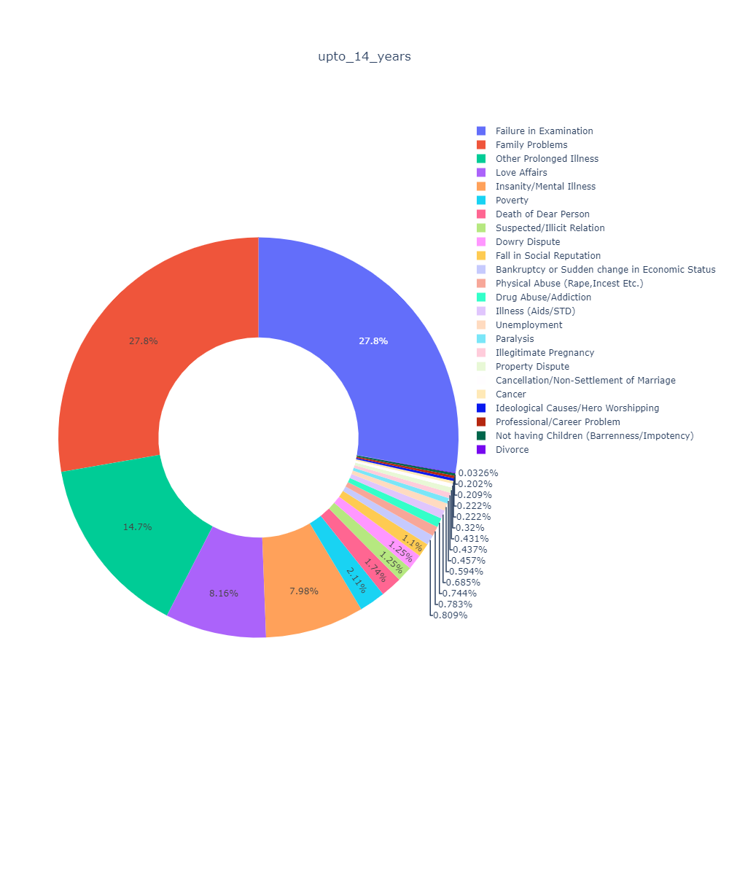
Top 3 reasons:
Failure in Examination
Family problem
Prolonged illness
UPTO 14 YEARS
55.6 % suicides is either due to failure in examination or due to family problems.

Slide 14
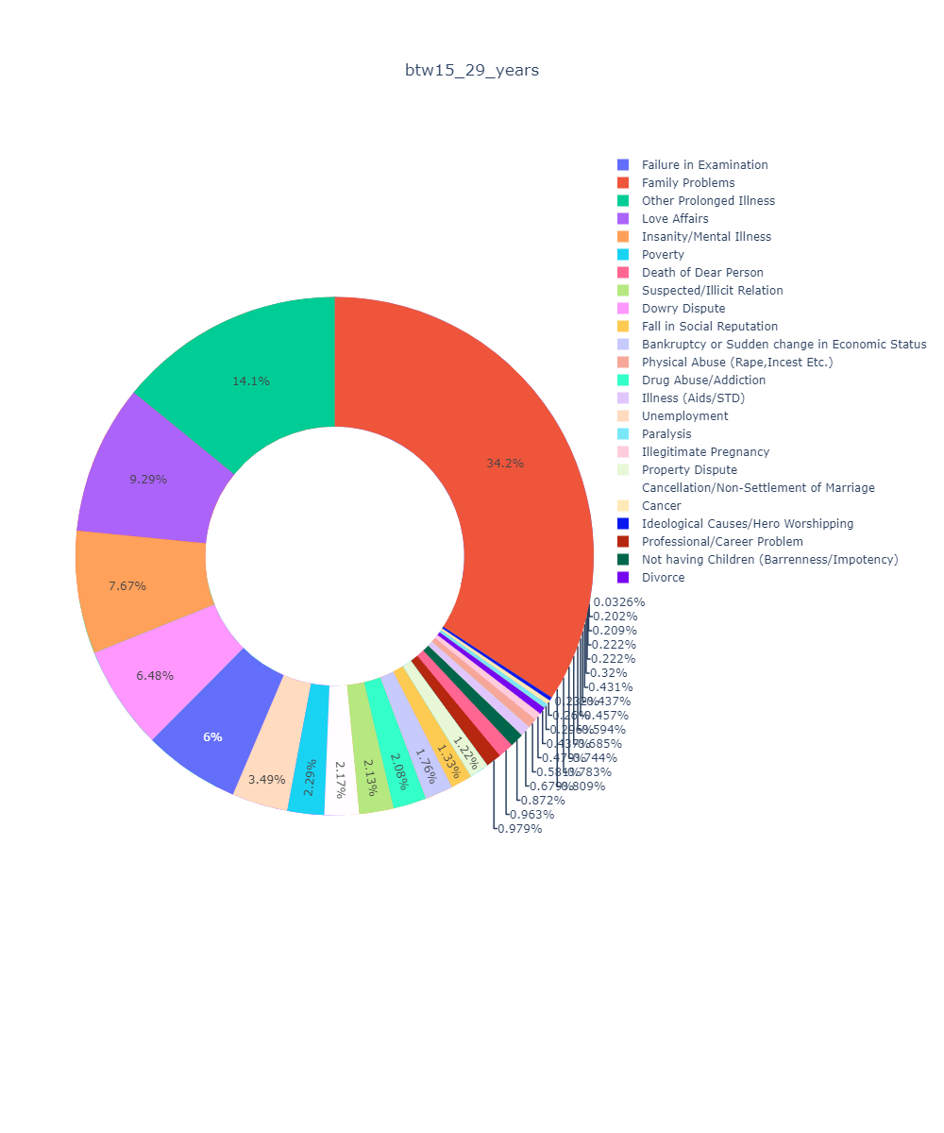
Top 3 reasons:
Family problem
Prolonged illness
Love affairs
BETWEEN 15 – 29 YEARS
One third of the people between 15 to 29 years of age commit suicide due to family problems.
14.1 % is due to prolonged illness and 9.29 % due to love failure.

Slide 15
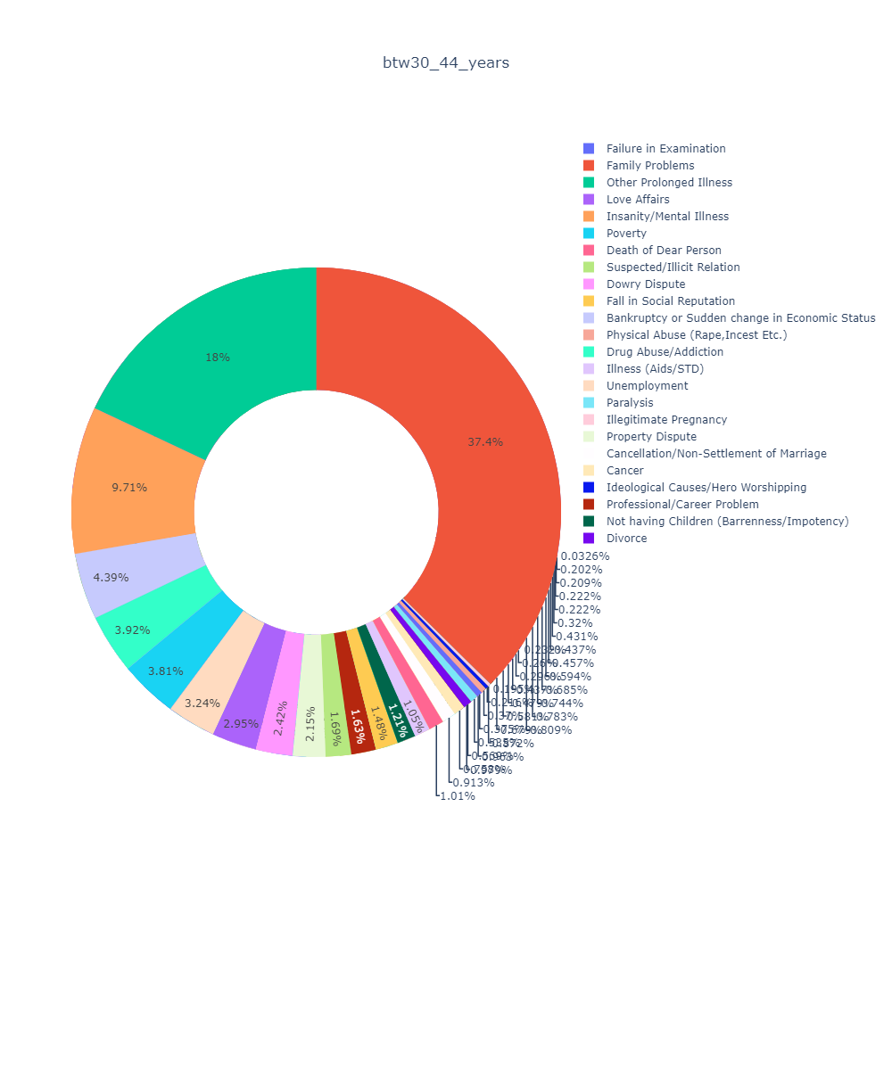
Top 3 reasons:
Family problem
Prolonged illness
Mental Illness
BETWEEN 30 – 44 YEARS
37.4% due to family problem.
18% and 9.71% due to prolonged illness and Mental illness respectively.

Slide 16
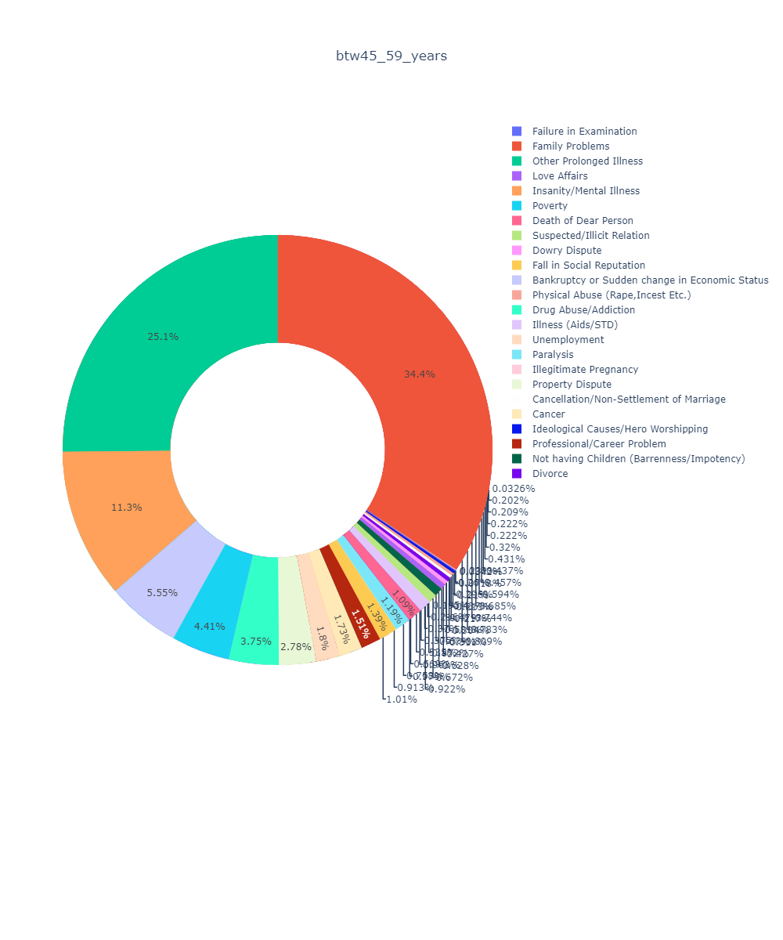
Top 3 reasons:
Family problem
Prolonged illness
Mental Illness
BETWEEN 45 – 59 YEARS
The top 3 reasons contribute 70.8% of the total.

Slide 17
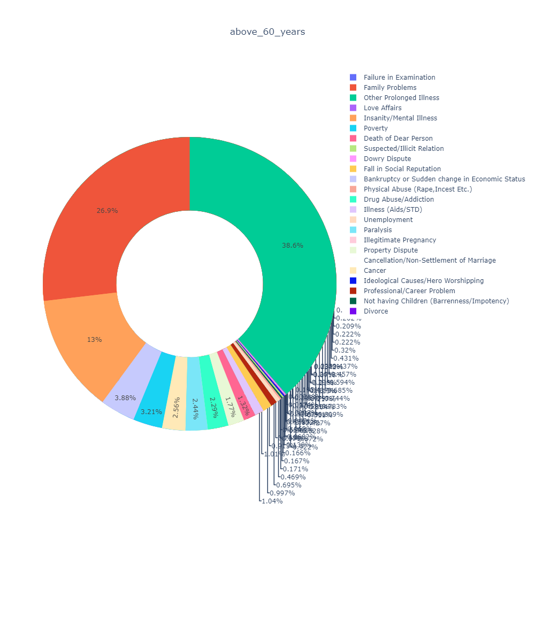
Top 3 reasons:
Prolonged illness
Family problem
Mental Illness
ABOVE 60 YEARS
After 60 years of age 50% committed suicide due to some kind of illness.

Slide 18
CONCLUSION
Most of the people who committed suicide belongs to the age group 15 to 44.
Number of male commit suicide is nearly double of female.
People commit suicide mainly due to Family problem, Prolonged illness and Mental Illness.
Most number of people committed suicide due to bankrupt belongs to southern states in India.
Above the age of 30 most of the people commit suicide due to family problem, prolonged illness or mental illness.

Slide 19
Thanks!

